Slide 1

Financial Data Analytics
Presentation by-
Uttam Kumar Mahato

Slide 2

Table of Contents
FINANCIAL ANALYTICS
Loading Data From Email to Power BI automatically.
Cleaning Data in Power Query Solving 10 Buisness Problems

Slide 3






TOOLS USED
FINANCIAL ANALYSIS
EMAIL

Slide 4
PROBLEM STATEMENT 1
FINANCIAL ANALYTICS
Current Workflow Overview
Each day around 3 PM, we receive ~25 data files via email from a geographically distributed survey team. These files are critical for building a dashboard, which must be completed and delivered to our client (the US government) by 8 PM. The process involves:
Downloading files from email
Combining them into one consolidated file Cleaning the data for consistency and accuracy Building and updating the dashboard
Delivering final insights to the client
Key Challenges:
Time-Consuming: Significant time is spent on downloading, merging, and cleaning files, causing delays. High Costs: Hiring two additional staff to handle this has added $12,000/month in expenses.
Error-Prone: Frequent data manipulation errors delay output and affect accuracy.
Workload Pressure: The intensive daily workflow is affecting other project timelines and overall team efficiency.
Objective:
We need solutions to:
Reduce turnaround time for file handling and processing Minimize errors in data manipulation
Cut costs by reducing dependency on manual labor Streamline workload to improve overall team productivity
Your insights on automating or optimizing this workflow would be immensely helpful in boosting efficiency and performance.

Slide 5
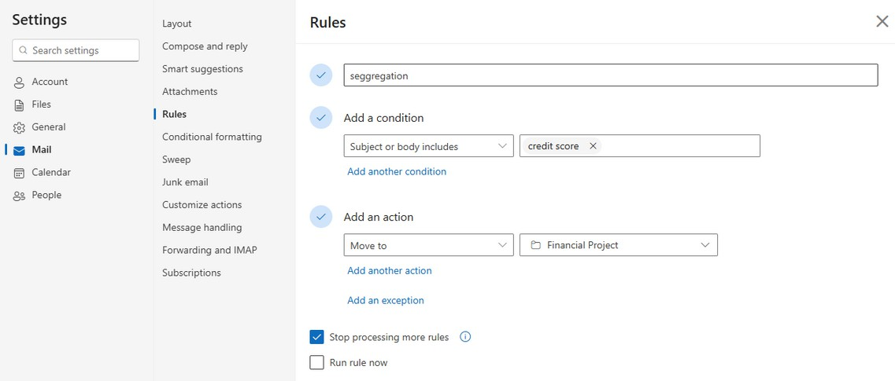

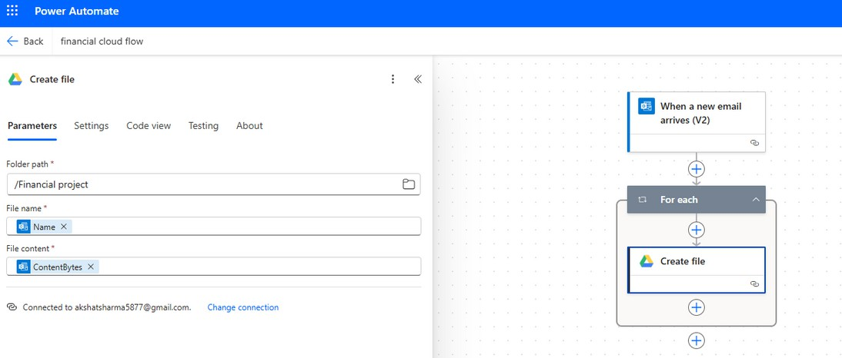

SOLUTION OF PROBLEM STATEMENT 1
FINANCIAL ANALYTICS
STEP 1:
Create an Outlook account and set up a mail rule (Settings
> Rules > Add new rule) to automatically move emails containing "credit score" in the subject or body to a dedicated folder named "Financial Project". This ensures all relevant daily analytics emails are stored in one place.
STEP 2:
Create a folder in Google Drive named "Financial Project", and then use Power Automate to transfer attachments from the Outlook "Financial Project" folder to this Google Drive folder, streamlining data collection for analysis.

Slide 6
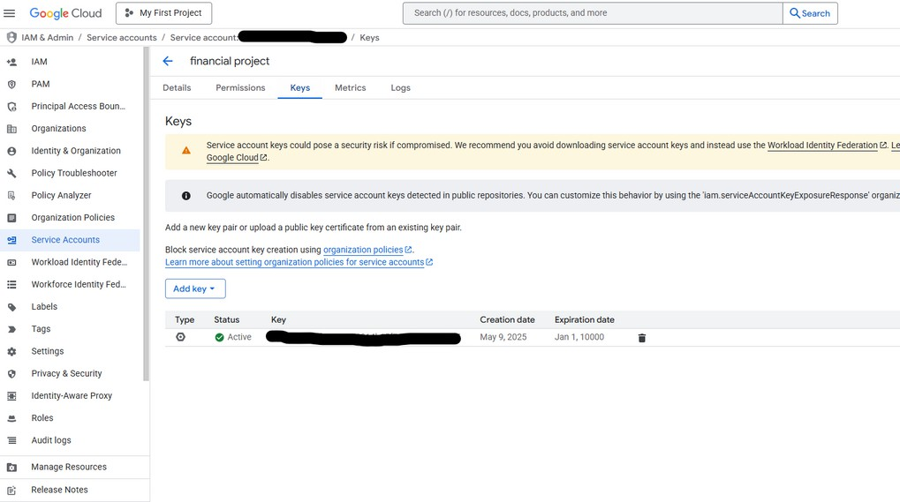
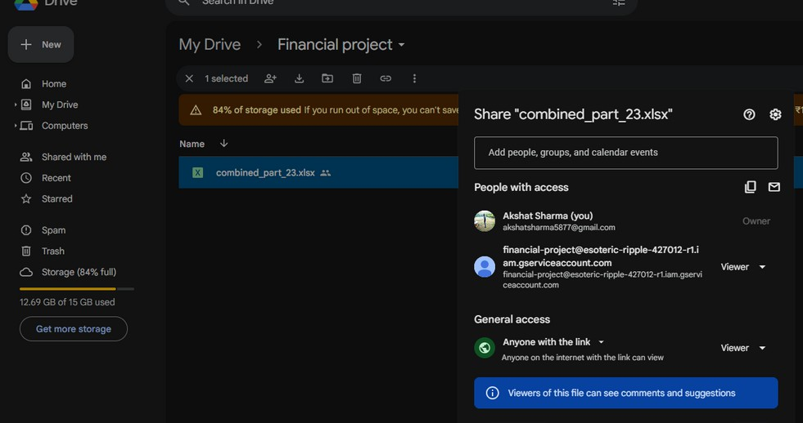
SOLUTION OF PROBLEM STATEMENT 1
FINANCIAL ANALYTICS
STEP 3:
To get the data from Google Drive into Power BI Desktop, a direct connection isn’t possible since they are separate platforms. To bridge this, we’ll create an API using Google Cloud Platform (GCP). By enabling the Google Drive API and generating the necessary credentials, we can securely access and fetch the Drive-stored data into Power BI Desktop for analysis.
STEP 4:
To ensure the API only accesses the Financial Project folder in Google Drive, we need to restrict its access. After creating the API, copy the service account email generated in GCP, then go to Drive > Financial Project > Share, paste the service email, and click "Add". This grants the API permission to access only that specific folder.

Slide 7
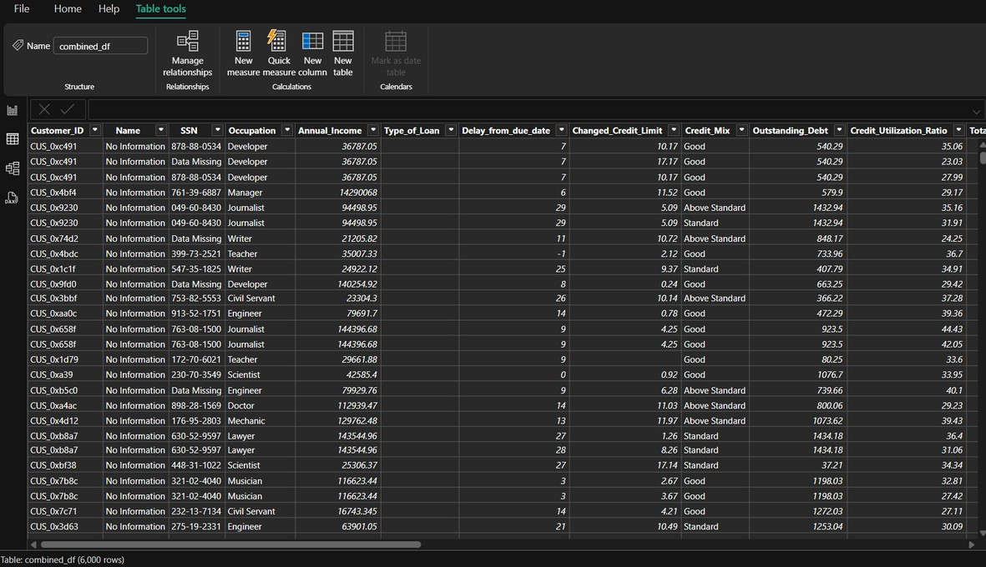

SOLUTION OF PROBLEM STATEMENT 1
FINANCIAL ANALYTICS
STEP 3:
Now, open Power BI Desktop and go to:
Get Data > More > Python Script, then add the script saved in resources folder.
This Python script uses the credentials downloaded during API creation to access the "Financial Project" folder in Google Drive, fetch all the files, and concatenate them into a single combined_df for further analysis in Power BI.
DATA OVERVIEW
Now, if any team sends data via email, it will automatically flow into Power BI through the following streamlined pipeline:
Email → Power Automate → Google Drive → API → Python Script → Power BI.
This end-to-end automation ensures real-time data ingestion with minimal manual effort.

Slide 8

CLEANING DATA
FINANCIAL ANALYTICS
To prepare the dataset for analysis, I carried out a series of data cleaning steps using Power Query:
Name Column: I began by replacing any blank entries in the Name column with the phrase "No Information" to handle missing data.
Age Column: Underscores (_) were removed and the data type was converted to whole numbers. I then created a custom column to handle outliers
—ages below 12 or above 95 were replaced with the median age. The original column was dropped and the new one renamed to Age.
SSN Column: Invalid or garbage values were standardized by replacing them with "Data Missing" for clarity.
Annual Income: Similar to the age column, underscores were removed and the data type was set to whole number.
Monthly Salary Calculation: I introduced a new column, monthly_in_hand_salary, calculated by deducting 10% tax from the annual income and dividing the result by 12.
Bank Accounts: To address any unrealistic values in Num_Bank_Accounts, I replaced values outside the 0–10 range with the column’s median.
Credit Cards: Likewise, for Num_Credit_Card, values equal to or above 25 were considered outliers and replaced with the median.
Interest Rate: Any value exceeding 34 was treated as invalid and substituted with the median interest rate.
Number of Loans: I extracted the number of loans by splitting the Type_of_Loan field using a comma delimiter and counting the resulting items. If the field was empty, the count was set to 0.
Credit Limit & Monthly Investment: I cleaned the Changed_Credit_Limit and Amount_Invested_Monthly columns by removing underscores and converting the values to whole numbers.
Credit History Age: A new column was created to convert the credit history from text (e.g., "2 Years and 5 Months") to total months for consistency in analysis.
Age Binning: Finally, I created a conditional column to categorize customers into age bins, making it easier to group and analyze data by age segments.

Slide 9
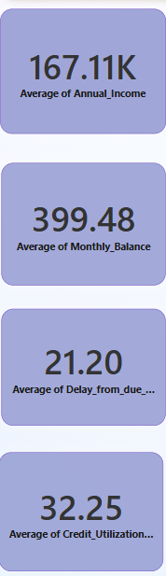
PROBLEM STATEMENT 2
FINANCIAL ANALYTICS
Show information’s like
Average Annual Income. Average Monthly balance.
Average number of payment delays. Average Credit Utilisation.
SOLUTION OF PROBLEM STATEMENT 2
To answer this question,
I used the Card visual in Power BI to display the following key metrics:
Average Annual Income: ₹171.25K Average Monthly Balance: ₹394.70 Average Delay in Payment: 21.02 days Average Credit Utilization: 32.17%

Slide 10
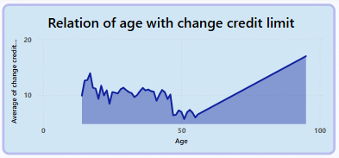
PROBLEM STATEMENT 3
FINANCIAL ANALYTICS
Investigate the relationship between age and changes in credit limit. Analyse how variations in customer age correlate with adjustments in their credit limits to understand if and how age-related factors influence credit limit changes. This insight can help in tailoring credit products and strategies based on different age demographics. How is the payment behaviour of people different for different credit mix categories?
SOLUTION OF PROBLEM STATEMENT 3
To explore the link between age and changes in credit limit, I used a line chart in Power BI.
The chart shows that younger customers (under 25) experience higher average changes, while changes decline steadily with age, becoming more stable after 30.
This suggests that younger users face more credit adjustments due to evolving financial behavior, while older customers have more stable credit profiles, guiding age- specific credit strategies.

Slide 11
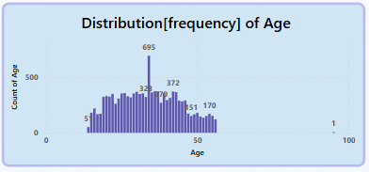
PROBLEM STATEMENT 4
FINANCIAL ANALYTICS
Generate a distribution plot to visualise the age demographics of the customer base. This plot should illustrate the frequency and distribution of various ages to provide insights into the age profile of the population served, aiding in targeted marketing and service strategies.
SOLUTION OF PROBLEM STATEMENT 4
To visualize the age demographics of the customer base, I used a bar chart as a count plot.
The plot shows a wide age spread, with noticeable spikes around ages 22, 34, and 44.

Slide 12
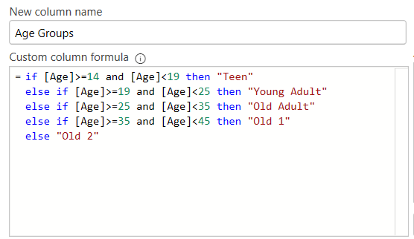
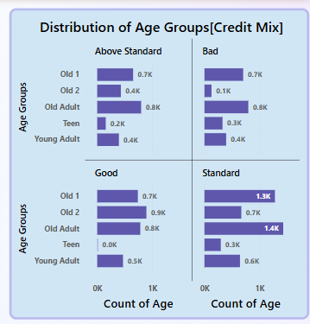
PROBLEM STATEMENT 5
FINANCIAL ANALYTICS
Client want to see a number of people of different age groups having different kinds of credit scores.
for making the age group consider the following rule: - 14-19 “Teen”
19-25 “Young Adult”
25-35 “Old Adult”
35-45 “Old1”
>45 “Old2”
SOLUTION OF PROBLEM STATEMENT 5
To analyze how credit scores vary across different age groups, I first created a
custom column on the basis of age to create above bins.
Then, I used a bar chart with small multiples by Credit Score categories to show the count of people in each age group for each credit score type (Above Standard, Good, Standard, Bad).
This visual helps compare how credit score distribution shifts with age, revealing that:
Teens and Old2 show lower counts, while Old1 and Old Adult dominate in most categories.
Bad scores are noticeably higher among Teens and Old Adults, highlighting segments with potential risk.

Slide 13
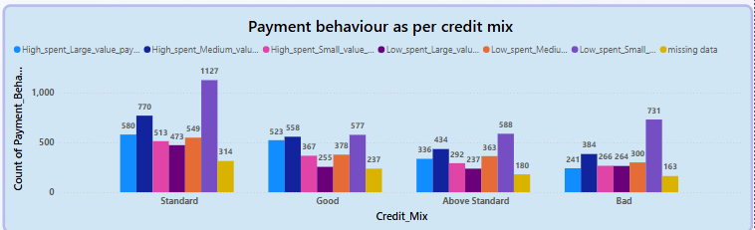
PROBLEM STATEMENT 6
FINANCIAL ANALYTICS
Analyse the frequency of various payment behaviours within each credit mix category. Examine how often different payment behaviours occur across different types of credit mixes .This analysis will provide insights into payment behaviour trends associated with each credit mix, helping to tailor risk management and credit strategies.
SOLUTION OF PROBLEM STATEMENT 6
To analyze payment behavior across credit mix categories, I used a clustered bar chart that displays the count of people for each payment behavior within every credit mix category.

Slide 14
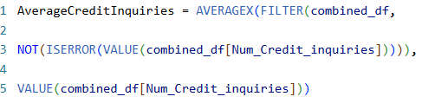
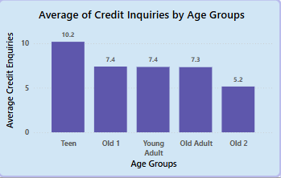
PROBLEM STATEMENT 7
FINANCIAL ANALYTICS
From the data available, is it possible to know the age group of my potential customers (for approaching loans), if yes then please show how.
SOLUTION OF PROBLEM STATEMENT 7
We used a bar chart with a DAX measure to calculate the average number of credit enquiries per age group. The Teen (14–19) group had the highest average (7.2), making them the most likely to approach for loans. The Old2 (>45) group had the lowest (3.3).

Slide 15
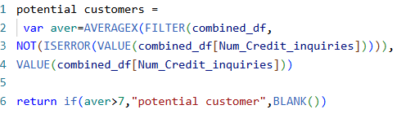
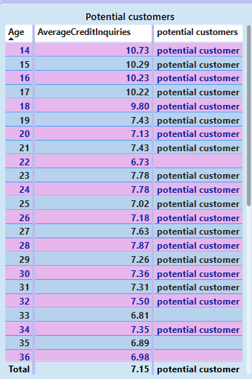
PROBLEM STATEMENT 8
FINANCIAL ANALYTICS
From the data of previous task, I got clear that, I have few ages group as potential customers, however now I want in depth study of it, all those ages will be my potential customers where age average inquiry is more than 7
SOLUTION OF PROBLEM STATEMENT 8
To identify specific potential customers, I created a table using the same AvgCreditEnquiries measure from the previous task and applied a filter where average inquiries > 7
This helped highlight specific ages (14–17) with high interest in loans, making them strong potential customer segments.

Slide 16
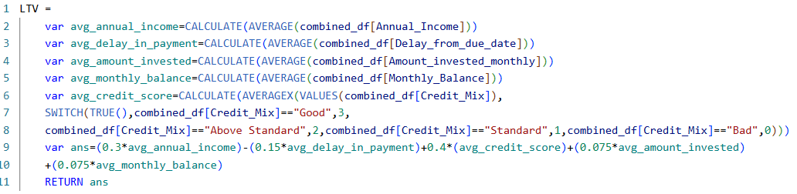
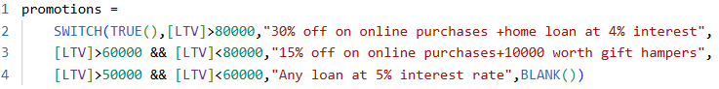
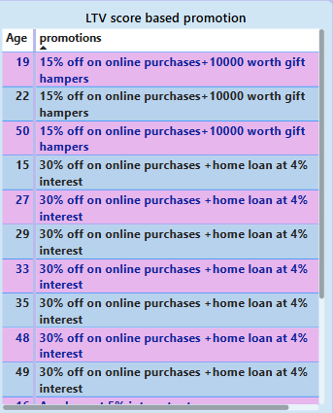
PROBLEM STATEMENT 9
FINANCIAL ANALYTICS
I shared your insights on the basis of age groups to higher management and they are very happy with your insights. They have asked to find LTV scores for each year group, and based on the LTV score roll out following promotions.
if LTV > 80000 - “30% off on online purchases +home loan at 4% interest”
LTV between (60000-80000) - “15% off on online purchases+10000 worth gift hampers” LTV between (50000-60000) - “Any loan at 5% interest rate”
to calculate LTV- use following formula -
LTV= (0.3*Average annual Income of the age)-(0.15*Average days in delay of payment from due date for that age )+0.4(Average of credit score[to calculate credit score go down good-3 bad -0])+(0.075*Average Amount Invested)+(0.075*Average Monthly balance)
SOLUTION OF PROBLEM STATEMENT 9
I calculated the LTV score using a measure and then created another measure called 'Promotion' to assign offers based on LTV. This helped identify which promotion to give each age group.
I used table chart for this question.

Slide 17
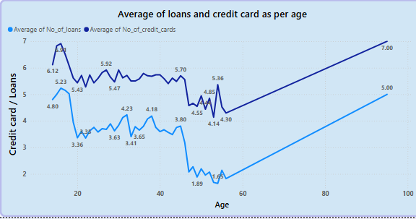
PROBLEM STATEMENT 10
FINANCIAL ANALYTICS
Calculate the average number of loans and credit cards held by customers across different age. Present these averages and analyse the data to uncover trends and insights related to credit card ownership by age. This analysis will help in understanding how credit card usage varies with age, which can inform targeted credit card offers and marketing strategies.
SOLUTION OF PROBLEM STATEMENT 10
I analyzed the average number of loans and credit cards by age using an area chart.
This helped uncover how credit card ownership varies across age groups, supporting better targeting for credit card offers.

Slide 18
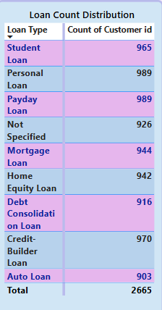
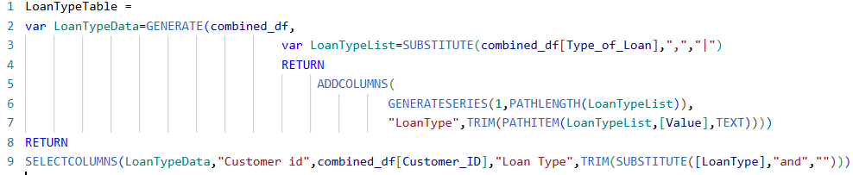
PROBLEM STATEMENT 11
FINANCIAL ANALYTICS
Please Create a visual that will show the count of each type of loans that are dispersed till now, this will help the company to keep a record of which is the most popular loans and roll out offers Accordingly.
SOLUTION OF PROBLEM STATEMENT 11
In the combined table customer may have multiple loan types listed in a single, comma-separated string to solve this we create a new table one row per customer-loan type combination

Slide 19
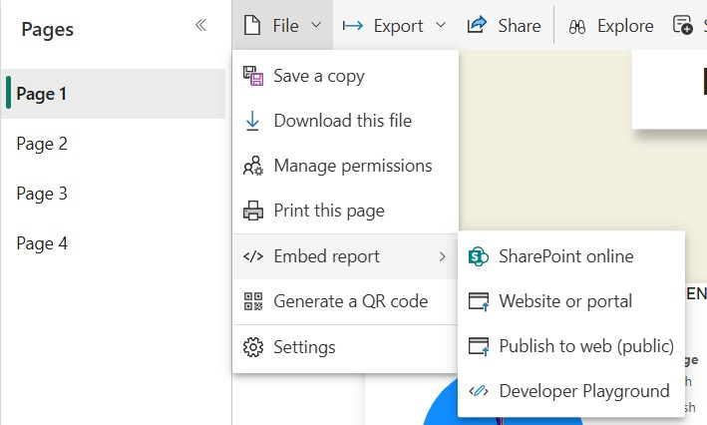




PUBLISHING TO POWER BI SERVICES
PUBLISH < FILE < EMBED REPORT < PUBLISH TO WEB
Link of the dashboard
https://app.powerbi.com/view?r=eyJrIjoiZjMxNDY3ZjMtZmU1Mi00NzMwLWIzNmUtOTBjYzJiODI4Nzg2IiwidCI6ImI1M2FmNGY3LTE2ZTUtNGJjOC1iNjM5LWZjNTE0YTA0ZDllYiJ9

Slide 20






Thank you

